Slide 1
MDT – Malt deployment toolkit
Phil Schwan
Solution Architect
Netrix LLC
Fred Bainbridge
Senior Consultant
NowMicro

Slide 2
Phil Schwan
Fred Bainbridge
@philschwan
@FredBainbridge
MCSE: Enterprise Devices & Apps, Mobility
Fantasy Baseball Champion
Almost 20 years desktop engineering
1 Year of Brewing
Running and Brewing FTW
Beer. (Not too cool for an IPA)

Slide 3
agenda

Slide 4
agenda
Why do we brew?
How does one brew?
What do you need?

Slide 5
Getting started - Expectations
“This was actually good.”
You can make good beer. It is easy. Great beer? Not so easy.
You are unlikely to save money, at least at first.
Lager vs. Ale
You will be brewing an Ale when you first start.

Slide 6
Getting started - WHY
Who makes a good brewer?
Likes good beer
Likes a good detailed process
Likes analytics
Has patience
Being a clean freak helps.

Slide 7
Getting started - TIPS
Don’t over do it on the equipment
Start Small
Keep it simple! SMASH

Slide 8
Brewing Basics
How does this all work?

Slide 9
Brewing Basics
Brewing Methods
All Grain vs Extract
How to Brew
1. Extract Sugar From Grain using hot water to make wort. (Mash)
2. Boil the wort for an hour. Add hops occasionally.
3. Cool the boiled wort.
4. Add yeast and store for 3+ weeks.
5. Bottle if needed.
Notes:
We are going to be talking about all grain brewing. It is way more fun. Extract brewing is great, you can make good beer with extract brewing. But, again, grain brewing is more fun.
Here is how you

Slide 10
BREW DAY!!
It’s a great day.
Notes:
We are going to walk through a bew day in great detail here. Stopping to talking in detail about the process and equipment.

Slide 11
Brew Day Tips
Give yourself enough time.
Have patience.
Have a clean workspace.
Be Prepared
Notes:
We are going to be talking about all grain brewing. It is way more fun. Extract brewing is great, you can make good beer with extract brewing. But, again, grain brewing is more fun.
Here is how you

Slide 12
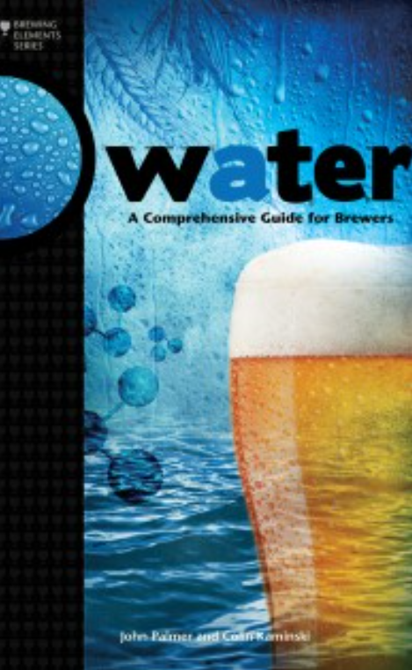
The night before (WATER PREP)
Water. Your first opportunity to geek out.
Get a water report, you have to call for this
Water profile can dictate what beers you can make well.
BOOK: Water: A Comprehensive Guide for Brewers
Pour the water the night before
Bypass your water softener! (unless you want a salty beer)
Chlorine tastes bad. Leave water out over night to dissapate.
Did you forget? Camdem Tablets (potassium metabisulfite)
Notes:
Some water can’t make some beers. This is a hard truth you may have to deal with.

Slide 13
The Mash (Extracting Sugar FROM GRAINS)
“Mashing is the brewer's term for the hot water steeping process which hydrates the barley, activates the malt enzymes, and converts the grain starches into fermentable sugars.”
"- John Palmer
The Equipment (Mash Tun)
[PICTURE]
How to build
Notes:
You can buy a mash tun or you can build your own. Any standard 48 quart picnic cooler will work. What you

Slide 14
The Mash (Continued)
The goal is to get your grain soaking in water between 148-160 degrees for an hour.
Over 170 degrees will stop all enzyme reactions.
Under 140 degrees will not get the right enzymes extracted.
You don’t want the temp to drop more than 5 degrees during the mash.
A standard coleman cooler can do this without problem.
Notes:
Some water can’t make some beers. This is a hard truth you may have to deal with.

Slide 15
starting The Mash - WATER
Heat the Mash Tun! (add hot water, close the lid, swish it around)
Amount of water to use (Ratio) - quarts of H20 / lbs of Grain
1.5 is fine.
Strike Temp
(.2 / RATIO) * (TargetTemp – InitialTemp) + TargetTemp
Or appx 12 degrees hotter than your desired mash temp.
To hot? Stir it up. Too Cold? Add hot water.
Notes:
Heat the mash tun so as not to loss heat when adding water. Have thermometer handy, a grill thermometer works great.

Slide 16
Adding grain to the Water
Add the grain to the water.
Check your temp and make sure you are at your desired temp.
Stir to cool, add water to heat it.
Stir up the grains gently, but thoroughly! You have to break up all the dough balls in order to get good extraction.
Have a big perforated paddle for this.
Close up the cooler and let the chemistry happen.
Notes:
If

Slide 17
Advanced Mash - PH
The desired PH level for your mash is between 5.0 and 5.6.
Depending on your water and grain this can be challenging to hit.
You can make good beer if your mash PH is off.
Every 10-15 minutes you can take a sample from the Mash tun and measure the PH and see how you are doing.
Manipulating the Mash
Grains -> Dark grains will lower your mash
Acid will lower you rmash PH
Sodium Bicarbanate will raise your mash PH.
Notes:
If you are screwing around with this, either know your chemistry or use a tool to help you. You need an accurate water report and a decent PH tester if you want to get serious about controlling your PH.
You may be lucky and have good water and never have to worry about this. (i.e. Chicago)

Slide 18
The Boil
Notes:
Some water can’t make some beers. This is a hard truth you may have to deal with.

Slide 19
Basics
Water
Grain
Yeast
Fermentation

Slide 20
Prepare the water in advance.
Bypass your water softener.
Chlorine tastes bad. Leave it out over night to rid yourself of that trash.

Slide 21
Brewing Tips and Tricks
How does do I not screw this up?

Slide 22
Brewing Automation
IoT - Intoxication of Things?

Slide 24


Slide 25
agenda

Slide 26
Title
Line1
Bullet Level 1
Bullet Level 2
Bullet Level 3

Slide 27
Title
Code

Slide 28
Text Only with Border
Level 1
Level 2
Level 3

Slide 29
Text Only (Red)
Level 1
Level 2
Level 3

Slide 30
Title
Text 1
Level 1
Level 2
Level 3
Text 2
Level 1
Level 2
Level 3

Slide 31
Title
Section 1
Section 2
Text
Level 1
Level 2
Level 3
Text
Level 1
Level 2
Level 3

Slide 32
Demo Title

Slide 33





























Slide 34






























Slide 35




























Slide 36




























Slide 37




























Slide 38




























Slide 39




























Slide 40























Slide 41
















